Slide 1
OPERATING SYSTEM
PROCESS STATES AND PCB

Slide 2
DEFINITION OF PROCESS
A process is an active program i.e a program that is under execution. It is more than the program code as it includes the program counter, process stack, registers, program code etc. Compared to this, the program code is only the text section.
A program is not a process by itself as the program is a passive entity, such as file contents, while the process is an active entity containing program counter, resources etc.

Slide 3
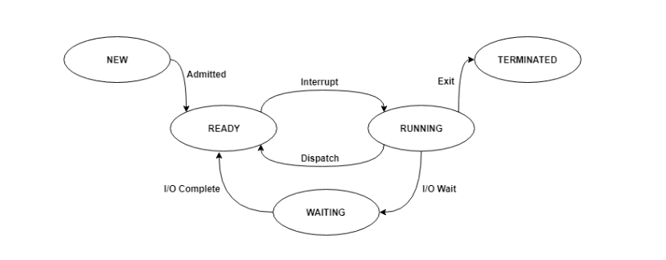
PROCESS STATES
A process changes its state as it executes.
This state partially depends on the current activity of a process.
The different states that a process is in during its execution are explained using the following diagram −

Slide 4
PROCESS STATES
New - The process is in the new state when it has just been created.
Ready - The process is waiting to be assigned the processor by the short-term scheduler.
Running - The process instructions are being executed by the processor.
Waiting - The process is waiting for some event such as I/O to occur.
Terminated - The process has completed its execution.

Slide 5
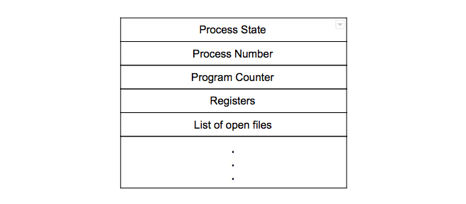
PROCESS CONTROL BLOCK
A process control block is associated with each of the processes.
It contains important information about the process it is associated with.

Slide 6
PCB
Process State - This specifies the process state i.e. new, ready, running, waiting or terminated.
Process Number - This shows the number of the particular process.
Program Counter - This contains the address of the next instruction that needs to be executed in the process.
Registers - This specifies the registers that are used by the process. They may include accumulators, index registers, stack pointers, general purpose registers etc.
List of open files - These are the different files that are associated with the process.

